Slide 1
Capstone Project – The Battle of Neighborhoods
Selecting the best location to open a Thai Restaurant in Manhattan,
New York City.

Slide 2
Introduction
The City of New York, is the most populous city in the United States. It is diverse and is
the financial capital of USA. It is multicultural. It provides lot of business opportunities
and business friendly environment. It has attracted many different players into the
market. It is a global hub of business and commerce.
Thai restaurants have become so popular in the United States now it seems that there is one on every corner,
not only in major cities but also in smaller cities. Starting a Thai restaurant can be a great
business opportunity, but you need to distinguish yourself from others to enjoy long-term
success.

Slide 3
Business Problem
The stakeholder wants to open his business in Manhattan area, so I focus on that borough
during my analysis. We define potential neighborhood based on the number of Thai
restaurants which are operating right in each neighborhood. Manhattan has full potential
but also is a very challenging district to open a business because of high competition. New
Thai restaurant should be opened in an area where the it can attract more customers.
Therefore, in this analysis it is necessary to ensure that we have enough customers and
that we are also close to other Thai outlets so that we get a good turnover of Thai food
lovers.

Slide 4
Data Selection
To identify the characteristics of our competitors' venues in Manhattan, we would first need to find out the number of Thai restaurants in Manhattan currently and their location.
We then used Foursquare API to find their geographic coordinates based on their postal code addresses.
In Manhattan, there are 992 Thai restaurants currently operating.

Slide 5
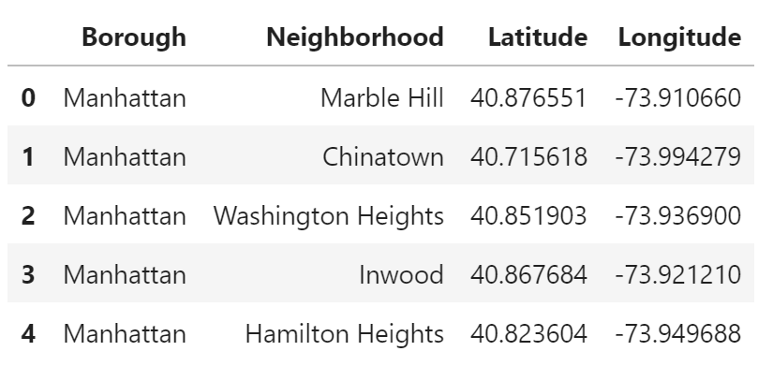
Data Selection
Next, we also used Foursquare API to find their geographic coordinates of the locations shortlisted:

Slide 6
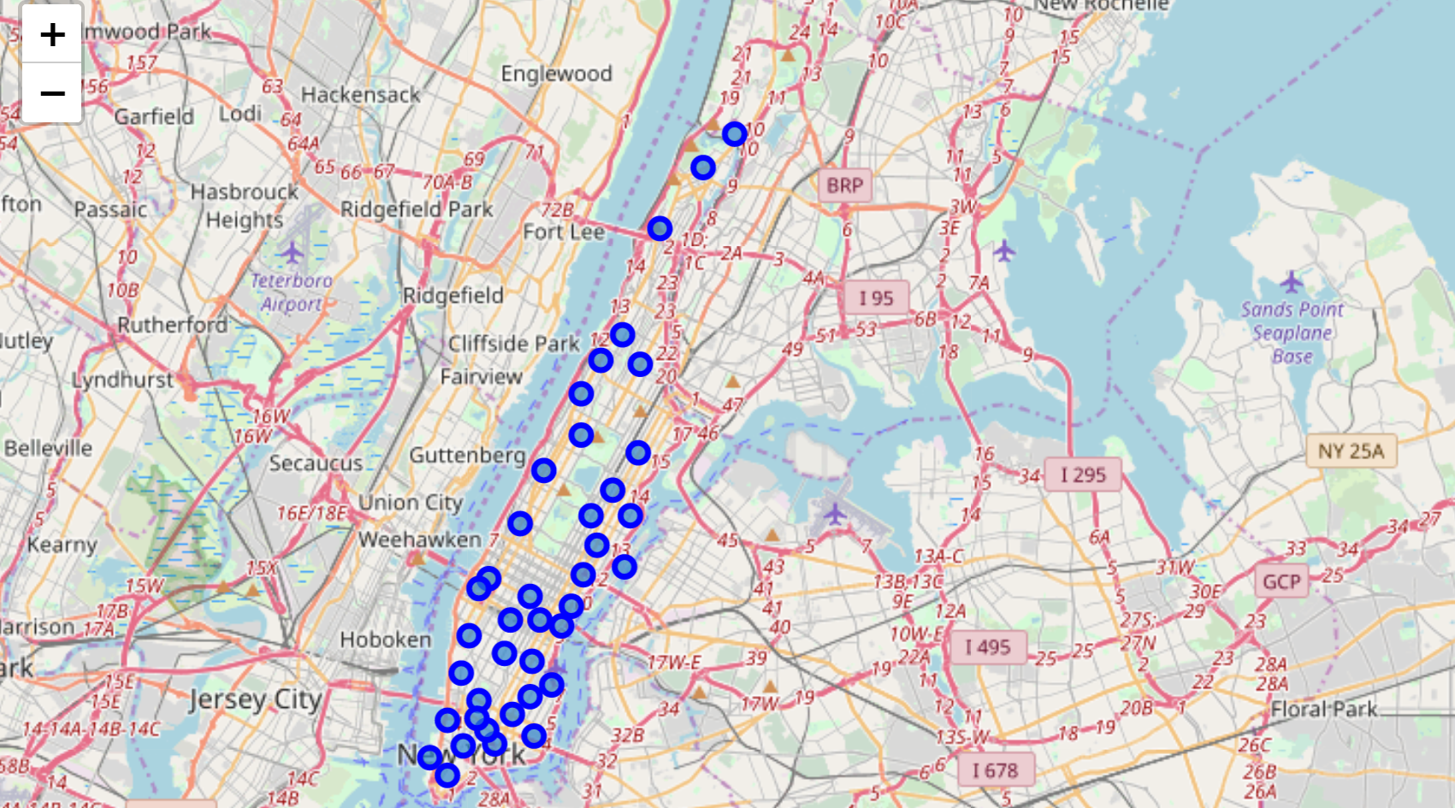
Data Selection
We plot a map of the data points using Folium.

Slide 7
Methodology
Addresses are converted into their equivalent latitude and longitude values.
Foursquare API is used to explore neighborhoods in Manhattan, New York.
After that, explore function is called to the API to get Thai restaurant categories in each neighborhood.

Slide 8
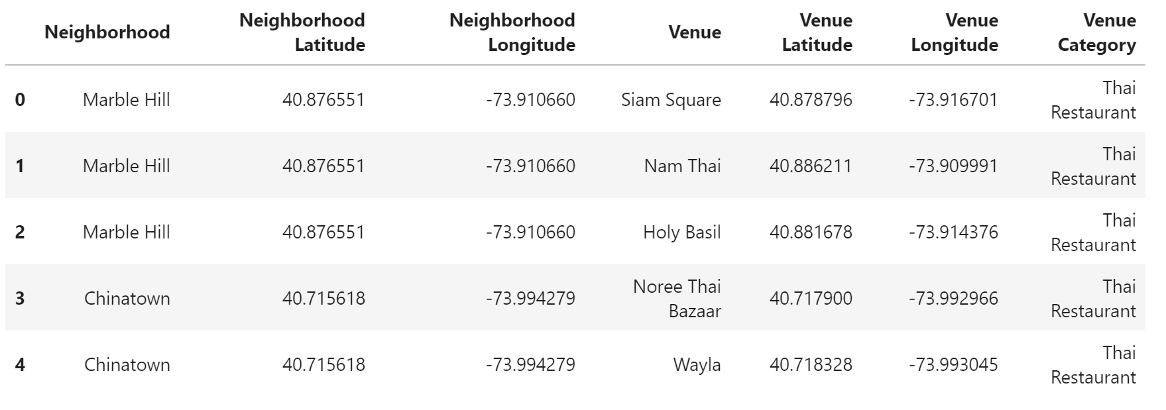
Methodology

Slide 9
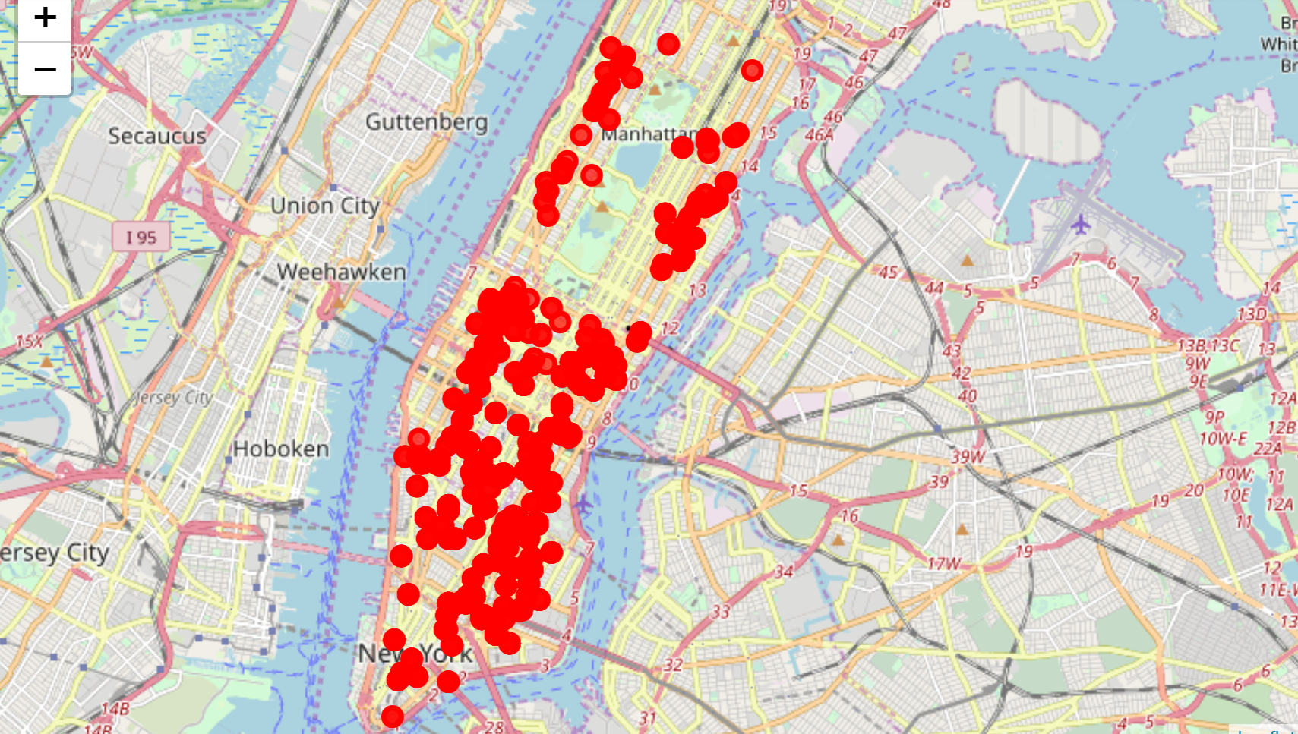
Methodology
Thai Restaurants in Manhattan

Slide 10
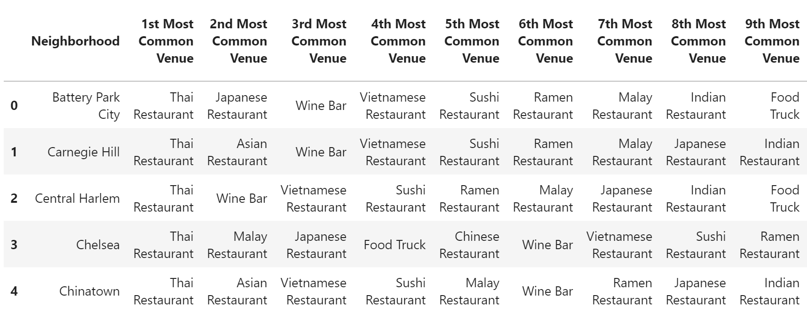
Methodology
Then using this feature set we grouped the neighborhoods into clusters. K-means clustering algorithm was used to generate the clusters. And also, the Folium library was used to visualize the neighborhoods in Manhattan and its emerging clusters.

Slide 11
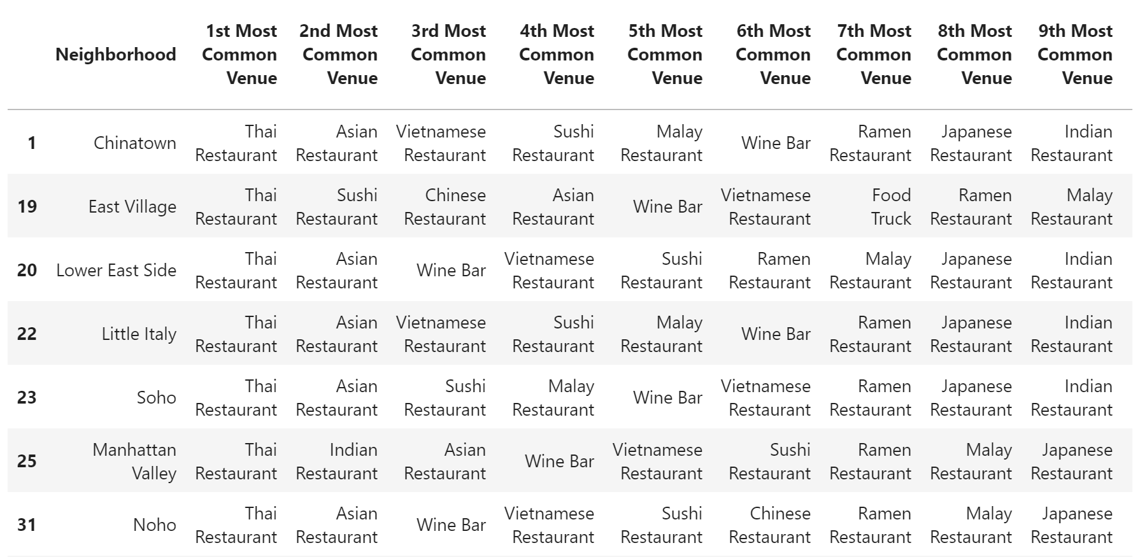
Results
Let's view the clustered data.
Cluster 0

Slide 12
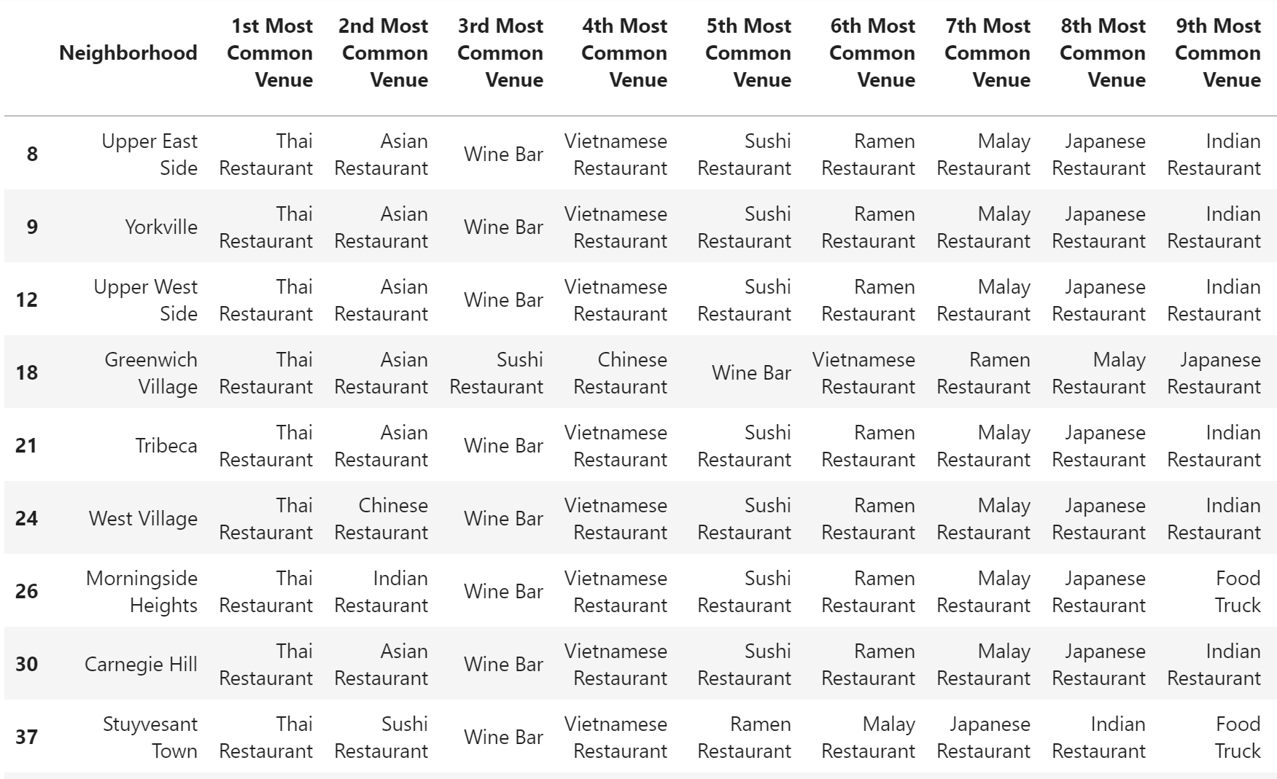
Results
Cluster 1

Slide 13
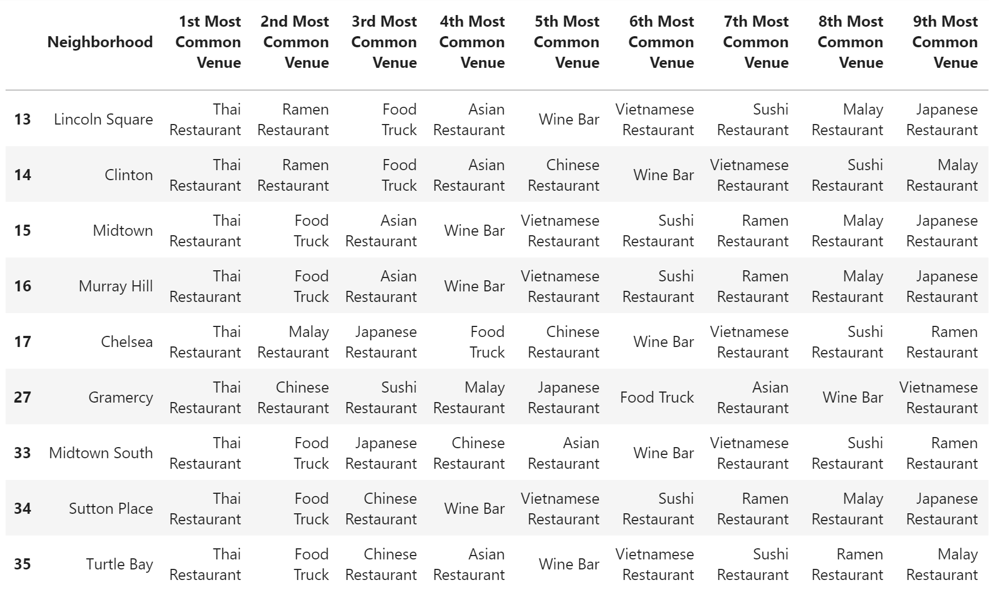
Results
Cluster 2

Slide 14
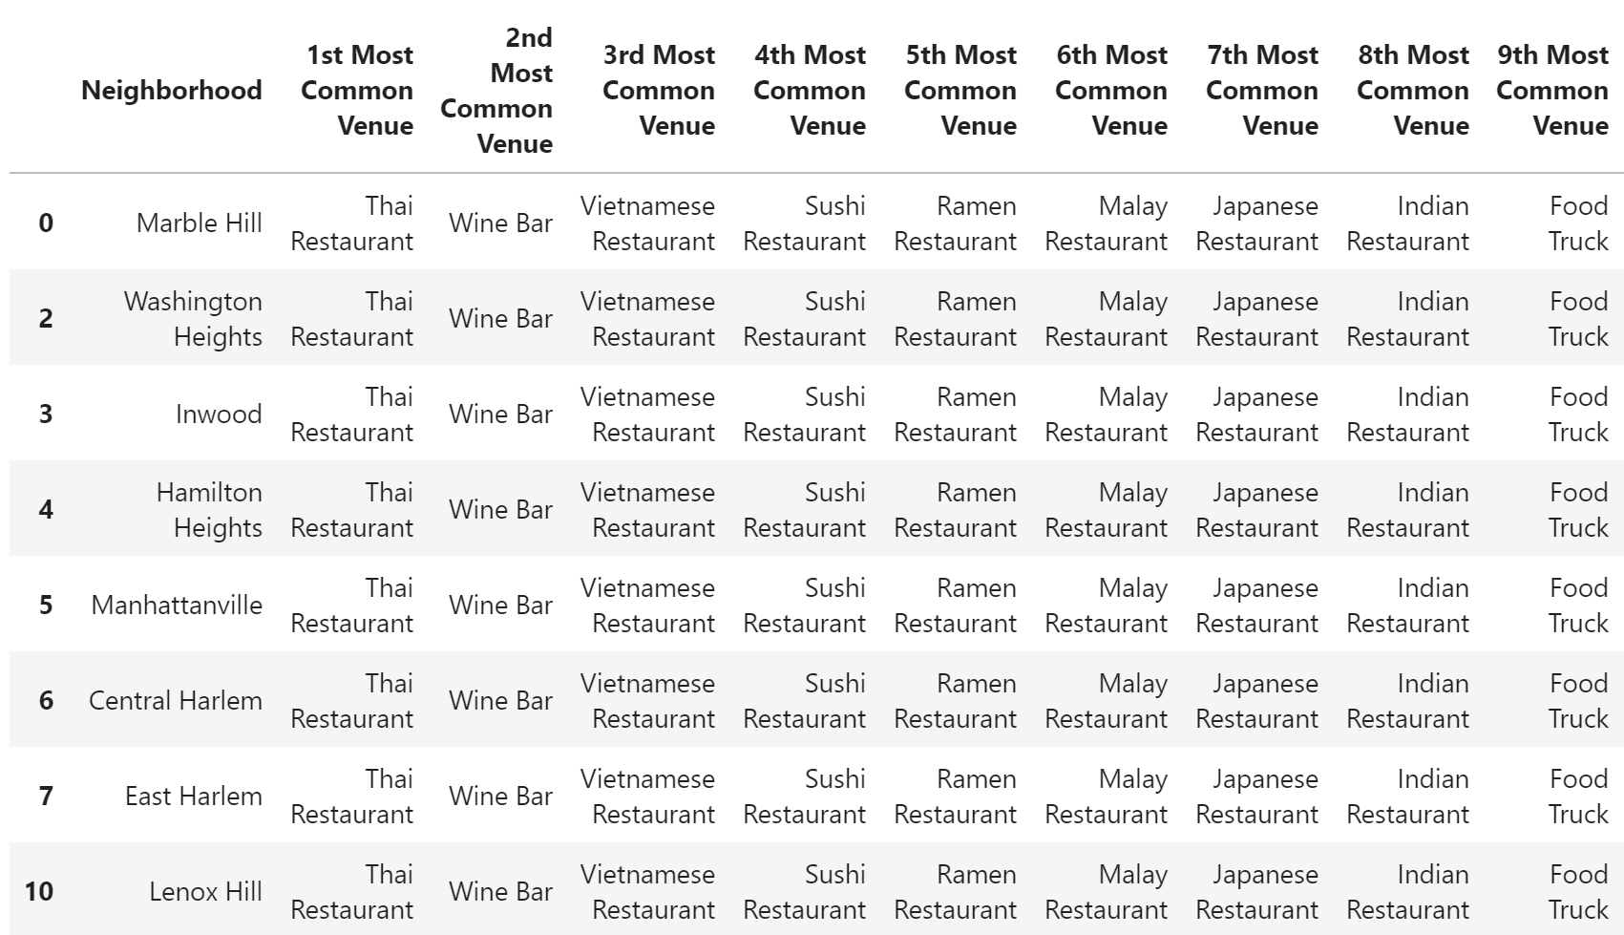
Results
Cluster 3

Slide 15
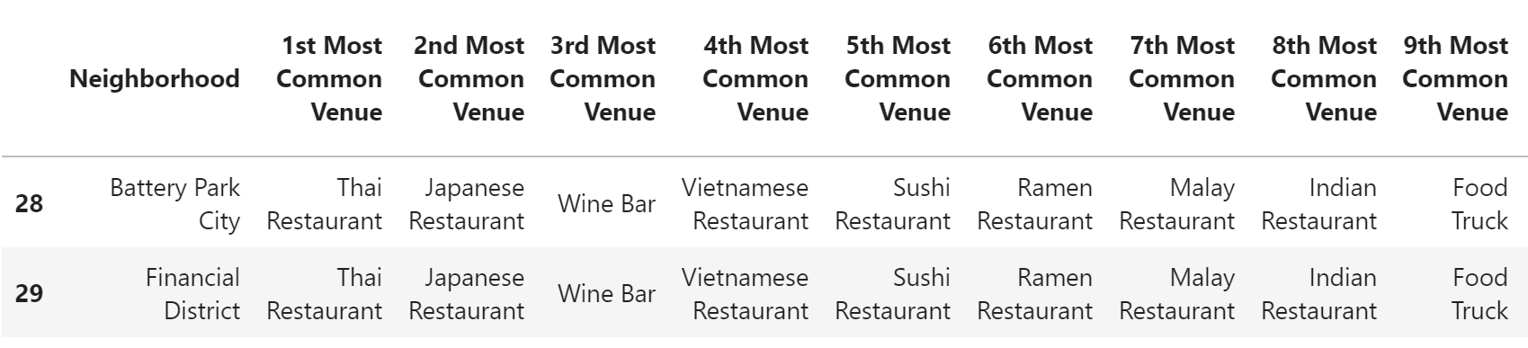
Results
Cluster 4

Slide 16
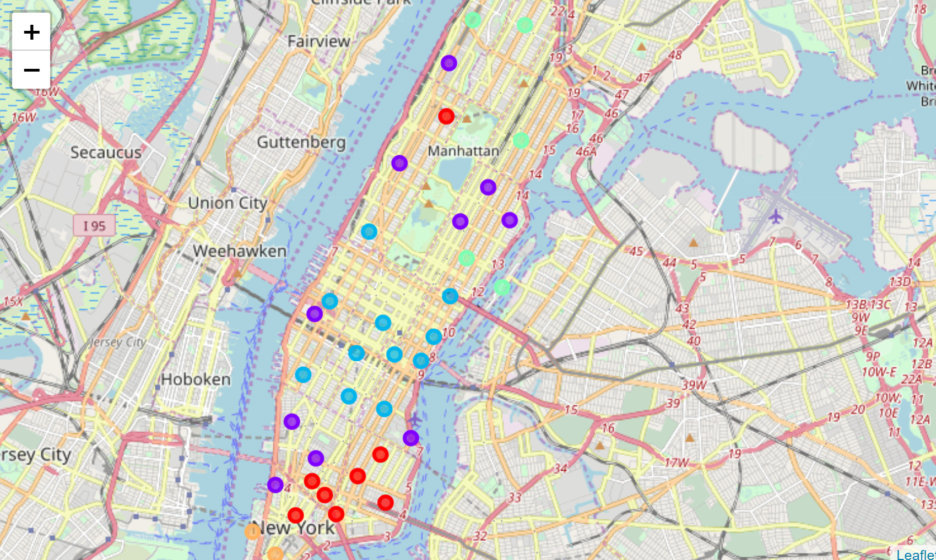
Results
After studying the cluster data from the dataframes and reviewing the cluster map, we come to the conclusion that most optimum area to open a new Thai Restaurant would be near Yorkville and Carnegie north of Upper East Side in Cluster 1.

Slide 17
Discussion
In this section, I would be discussing the observations I have noted and the recommendation that I can make based on the results.
This analysis is performed on limited data. Most optimum results may vary based on input parameters and also the initial cluster value input.
Also, few key highlights:
Washington Heights would be least favorable location to open a Thai restaurant pertaining to the sparsity in the region which may be as a result of people’s preferences.
More detailed analysis can be done and better results can be achieved by considering other factors such as transportation, demographics of inhabitants.

Slide 18
Conclusion
Although all of the goals of this project were met, there is definitely room for further improvement and development. However, this analysis can be used as a dependable guideline for any stakeholder planning to venture having this use case.
As per the neighborhood or restaurant type mentioned, this analysis can be referred to. A venue with lowest risk and competition can be identified.
The location parameters can be tweaked to match any requirements around the world provided proper location specific data is present.

